Slide 1
Azure Databricks
A Technical Overview
Nishant Thacker
Technical Product Manager
November 11th 2017

Slide 2
TOC
Spark Overview
Azure Databricks
Overview of the offering
Core Concepts
Secure Collaboration
Azure Active Directory Integration
Fine Grained Permission and Access Control
Core Artifacts
Clusters, Jobs, Notebooks, Libraries, Workspaces, Folders
Spark Application Workloads
Data Analytics, Stream Analytics, Machine Learning, Graph Processing
Performance
CLI and Rest APIs

Slide 3
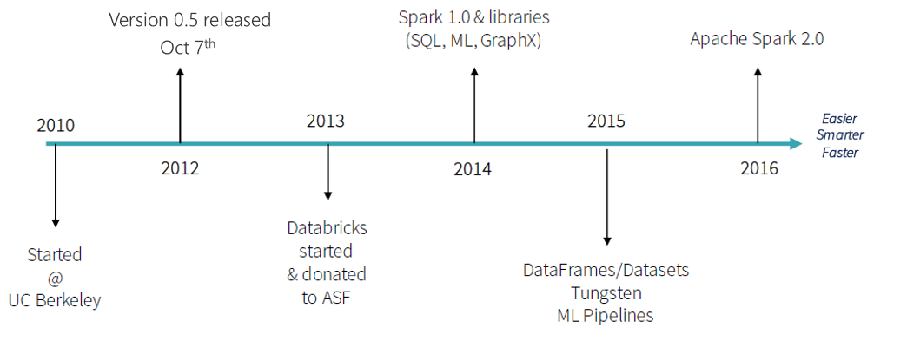
SPARK: A BRIEF HISTORY

Slide 4
APACHE SPARK
An unified, open source, parallel, data processing framework for Big Data Analytics
Spark SQL
Interactive Queries
Spark MLlib
Machine Learning
Spark Streaming
Stream processing
GraphX
Graph Computation
Spark Unifies:
Batch Processing
Interactive SQL
Real-time processing
Machine Learning
Deep Learning
Graph Processing
Spark Core Engine
Yarn
Mesos
Standalone Scheduler
Spark MLlib
Machine Learning
Spark Structured Streaming
Stream processing

Slide 5
SPARK - BENEFITS
Performance
Using in-memory computing, Spark is considerably faster than Hadoop (100x in some tests).
Can be used for batch and real-time data processing.
Developer Productivity
Easy-to-use APIs for processing large datasets.
Includes 100+ operators for transforming.
Unified Engine
Integrated framework includes higher-level libraries for interactive SQL queries, Stream Analytics, ML and graph processing.
A single application can combine all types of processing.
Ecosystem
Spark has built-in support for many data sources, rich ecosystem of ISV applications and a large dev community.
Available on multiple public clouds (AWS, Google and Azure) and multiple on-premises distributors

Slide 6
ADVANTAGES OF A UNIFIED PLATFORM
Input Streams of Events
Improves developer productivity—a single consistent set of APIs
All different systems in Spark share the same abstraction – RDDs (Resilient Distributed Datasets)
Developers can mix and match different kind of processing in the same application. This is a common requirement for many big data pipelines.
Performance improves because unnecessary movement of data across engines is eliminated. In many pipelines, data exchange between engines is the dominant cost
Spark Streaming
Spark Machine Learning
Spark SQL
NoSQL DB

Slide 7
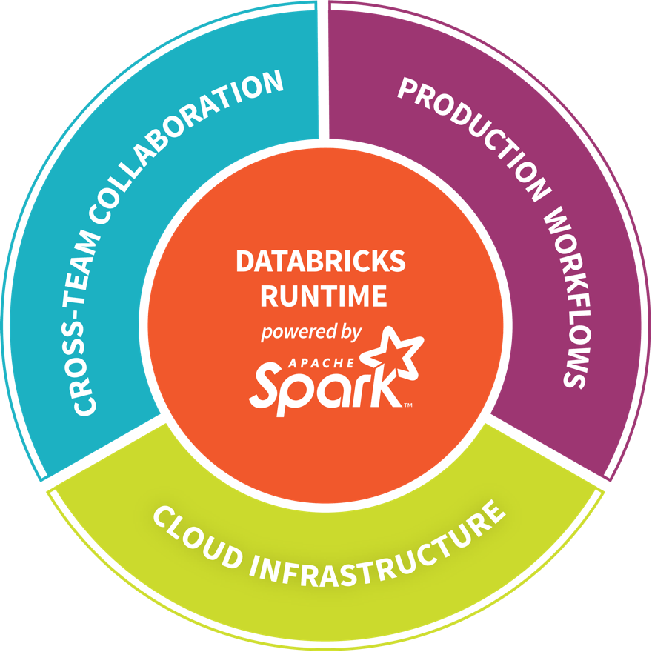
DATABRICKS - COMPANY OVERVIEW
Founded in late 2013
By the creators of Apache Spark, original team from UC Berkeley AMPLab
Largest code contributor code to Apache Spark
Level 2/3 support partnership with
Hortonworks
MapR
DataStax
Provides certifications such as Databricks Certified Application, Databricks Certified Distribution and Databricks Certified Developer
Main Product: The Unified Analytics Platform
In Oct 2017, introduced Databricks Delta (currently in private preview).

Slide 8
Azure Databricks Databricks Spark as a managed service on Azure

Slide 9

AZURE DATABRICKS
Azure Databricks is a first party service on Azure.
Unlike with other clouds, it is not an Azure Marketplace or a 3rd party hosted service.
Azure Databricks is integrated seamlessly with Azure services:
Azure Portal: Service an be launched directly from Azure Portal
Azure Storage Services: Directly access data in Azure Blob Storage and Azure Data Lake Store
Azure Active Directory: For user authentication, eliminating the need to maintain two separate sets of uses in Databricks and Azure.
Azure SQL DW and Azure Cosmos DB: Enables you to combine structured and unstructured data for analytics
Apache Kafka for HDInsight: Enables you to use Kafka as a streaming data source or sink
Azure Billing: You get a single bill from Azure
Azure Power BI: For rich data visualization
Eliminates need to create a separate account with Databricks.
Microsoft Azure

Slide 10



AZURE DATABRICKS
Azure Databricks
Collaborative Workspace
IoT / streaming data
Machine learning models
DATA ENGINEER
DATA SCIENTIST
BUSINESS ANALYST
Deploy Production Jobs & Workflows
Cloud storage
BI tools
MULTI-STAGE PIPELINES
JOB SCHEDULER
NOTIFICATION & LOGS
Data warehouses
Optimized Databricks Runtime Engine
Data exports
Hadoop storage
DATABRICKS I/O
APACHE SPARK
SERVERLESS
Rest APIs
Data warehouses
Enhance Productivity
Build on secure & trusted cloud
Scale without limits
Notes:
Databricks, founded by the team that created Apache Spark – unified analytics platform that accelerates innovation by unifying data science, engineering & business.
75% of the code committed to Apache Spark comes from Databricks
Unified Runtime
Create clusters in seconds, dynamically scale them up and down.
They’ve made enhancements to Spark engine to make it 10x faster than open source Spark
Serverless- Auto-configured multi-user cluster, Reliable sharing with fault isolation
Unified Collaboration
Overall – a simple & collaborative environment that enables your entire team to use Spark & interact with your data simultaneously
DE – Improve ETL performance, zero management clusters. Execute production code from within notebooks
DS - For data scientists, easy data exploration in notebooks
Business SME – interactive dashboards empower teams to create dynamic reports
Enterprise Security
Encryption
Fine grained Role-based access control (files, clusters, code, application, dashboard)
Compliance
Rest APIs
DE – DBIO, SPARK, API’s , JOBS
DS – Spark and Serverless, Interactive Data Science
Data Products - Everything
Creators of Spark
Training People
Number of Customers
Ingest
Workflow
Schedule / Run / Monitor
Execute
Troubleshoot
Debug
Production Jobs
---------
Ingest, ETL, Scheduling, Monitoring

Slide 11





POSITIONING THE DIFFERENT BIG DATA SOLUTIONS
KNOWING THE VARIOUS BIG DATA SOLUTIONS
CONTROL
EASE OF USE
Azure Data Lake
Analytics
Data Engineering in a
Job-as-a-service model
Azure Databricks
Frictionless & Optimized Spark clusters
Azure HDInsight
Workload optimized, managed clusters
Reduced Administration
Azure Marketplace
HDP | CDH | MapR
BIG DATA ANALYTICS
Any Hadoop technology, any distribution
IaaS Clusters
Managed Clusters
Big Data as-a-service
Azure Data Lake Analytics
Azure Data Lake Store
BIG DATA STORAGE
Azure Storage

Slide 12
LOOKING ACROSS THE OFFERINGS
Azure HDInsight
What It Is
Hortonworks distribution as a first party service on Azure
Big Data engines support – Hadoop Projects, Hive on Tez, Hive LLAP, Spark, HBase, Storm, Kafka, R Server
Best-in-class developer tooling and Monitoring capabilities
Enterprise Features
VNET support (join existing VNETs)
Ranger support (Kerberos based Security)
Log Analytics via OMS
Orchestration via Azure Data Factory
Available in most Azure Regions (27) including Gov Cloud and Federal Clouds
Guidance
Customer needs Hadoop technologies other than, or in addition to Spark
Customer prefers Hortonworks Spark distribution to stay closer to OSS codebase and/or ‘Lift and Shift’ from on-premises deployments
Customer has specific project requirements that are only available on HDInsight
Azure Databricks
What It Is
Databricks’ Spark service as a first party service on Azure
Single engine for Batch, Streaming, ML and Graph
Best-in-class notebooks experience for optimal productivity and collaboration
Enterprise Features
Native Integration with Azure for Security via AAD (OAuth)
Optimized engine for better performance and scalability
RBAC for Notebooks and APIs
Auto-scaling and cluster termination capabilities
Native integration with SQL DW and other Azure services
Serverless pools for easier management of resources
Guidance
Customer needs the best option for Spark on Azure
Customer teams are comfortable with notebooks and Spark
Customers need Auto-scaling and
Customer needs to build integrated and performant data pipelines
Customer is comfortable with limited regional availability (3 in preview, 8 by GA)
Azure ML
What It Is
Azure first party service for Machine Learning
Leverage existing ML libraries or extend with Python and R
Targets emerging data scientists with drag & drop offering
Targets professional data scientists with
Experimentation service
Model management service
Works with customers IDE of choice
Guidance
Azure Machine Learning Studio is a GUI based ML tool for emerging Data Scientists to experiment and operationalize with least friction
Azure Machine Learning Workbench is not a compute engine & uses external engines for Compute, including SQL Server and Spark
AML deploys models to HDI Spark currently
AML should be able to deploy Azure Databricks in the near future

Slide 13
Azure Databricks Core Concepts

Slide 14
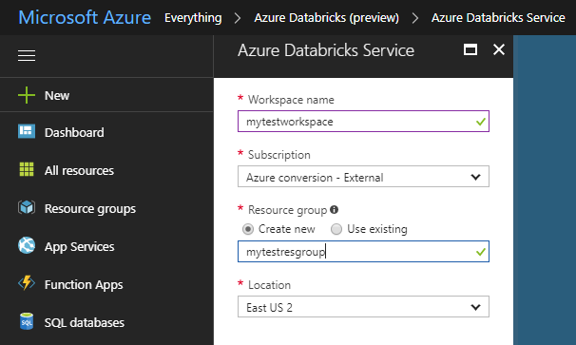
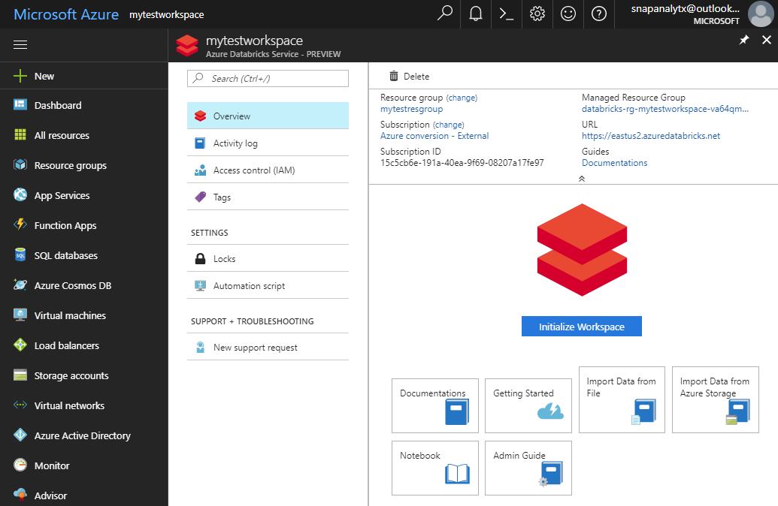
PROVISIONING AZURE DATABRICKS WORKSPACE
Azure Databricks is provisioned directly from the Azure Portal like any other Azure service
In contrast, with other clouds, it has to be provisioned through the Databricks portal.
With Azure Databricks, the Azure Portal offers a unified portal to provision and administer Azure Databricks as well as other Azure services.
Any Azure user with the appropriate subscription and authorization can provision Azure Databricks service*.
There is no need for a separate Databricks account
Provisioning the Azure Databricks Service
After provisioning the is complete
* During the current preview phase, the subscription has to be whitelisted.
Notes:
It is possible for a non-Azure user to access the Databricks cluster through a public URL. Such users have limited rights.

Slide 15
GENERAL SPARK CLUSTER ARCHITECTURE
Driver Program SparkContext
‘Driver’ runs the user’s ‘main’ function and executes the various parallel operations on the worker nodes.
The results of the operations are collected by the driver
The worker nodes read and write data from/to Data Sources including HDFS.
Worker node also cache transformed data in memory as RDDs (Resilient Data Sets).
Worker nodes and the Driver Node execute as VMs in public clouds (AWS, Google and Azure).
Cluster Manager
Worker Node
Worker Node
Worker Node
Cache
Cache
Cache
Task
Task
Task
Data Sources (HDFS, SQL, NoSQL, …)

Slide 16


AZURE DATABRICKS CLUSTER ARCHITECTURE
Spark History Server
Webapp
Log Daemon
Azure Compute
Spark Worker
Azure Compute
Azure DB for PostgreSQL
Spark Driver
Azure Compute
FileSystem
Service
Jobs
Cluster Manager
Azure Compute
Spark Worker
Log Daemon
Databricks’ Azure Account
User’s Azure Account
Resource in the Databricks’ account are not visible to users

Slide 17
CLUSTER MANAGER ARCHITECTURE
Cluster
Azure Compute
Webapp
Jobs
Spark Worker
Azure Compute
Spark Driver
Cluster Manager
Azure Compute
Spark Worker
Library Manager
Container Management
Instance Manager
Cluster
Azure Compute
Spark Worker
Azure Compute
Spark Driver
Azure Compute
Spark Worker
Database
Instances, Clusters, Libraries, Hive Metastore, …

Slide 18
Secure Collaboration

Slide 19





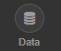
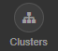
SECURE COLLABORATION
Azure Databricks enables secure collaboration between colleagues
With Azure Databricks colleagues can securely share key artifacts such as Clusters, Notebooks, Jobs and Workspaces
Secure collaboration is enabled through a combination of:
Fine grained permissions: Defines who can do what on which artifacts (access control)
AAD-based authentication: Ensures that users are actually who they claim to be
Fine Grained Permissions
AAD-based User Authentication

Slide 20
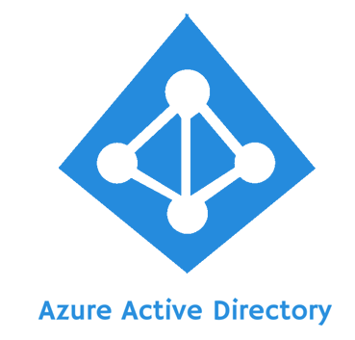


AZURE DATABRICKS INTEGRATION WITH AAD
Azure Databricks is integrated with AAD—so Azure Databricks users are just regular AAD users
There is no need to define users—and their access control—separately in Databricks.
AAD users can be used directly in Azure Databricks for all user-based access control (Clusters, Jobs, Notebooks etc.).
Databricks has delegated user authentication to AAD enabling single-sign on (SSO) and unified authentication.
Notebooks, and their outputs, are stored in the Databricks account. However, AAD-based access-control ensures that only authorized users can access them.
Access
Control
Authentication
Azure Databricks

Slide 21
DATABRICKS ACCESS CONTROL
Access control can be defined at the user level via the Admin Console
Access Control can be defined for Workspaces, Clusters, Jobs and REST APIs
Workspace Access Control | Defines who can who can view, edit, and run notebooks in their workspace
Cluster Access Control | Allows users to who can attach to, restart, and manage (resize/delete) clusters. Allows Admins to specify which users have permissions to create clusters
Jobs Access Control | Allows owners of a job to control who can view job results or manage runs of a job (run now/cancel)
REST API Tokens | Allows users to use personal access tokens instead of passwords to access the Databricks REST API
Databricks Access
Control

Slide 22
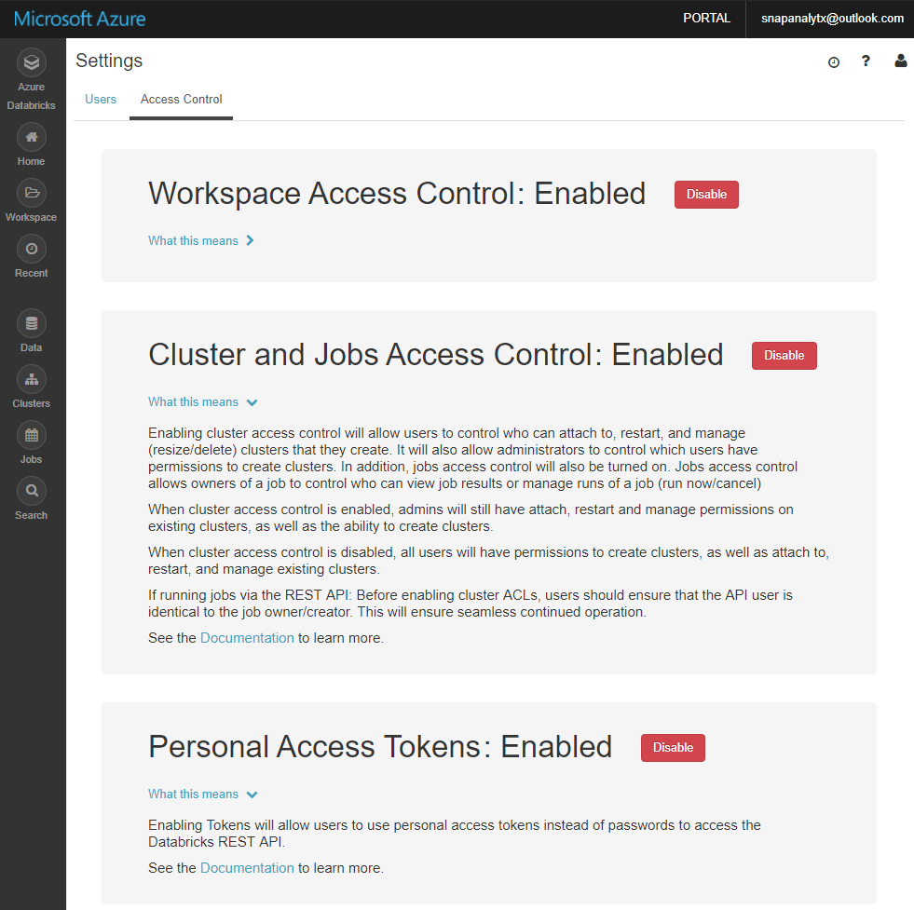
ENABLE/DISABLE ACCESS CONTROL
Access Control can be selectively enabled or disabled for:
Workspaces,
Clusters,
Jobs
REST APIs

Slide 23




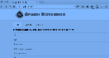
AZURE DATABRICKS CORE ARTIFACTS
Clusters
Libraries
Workspaces
Azure Databricks
Jobs
Notebooks

Slide 24
Clusters

Slide 25
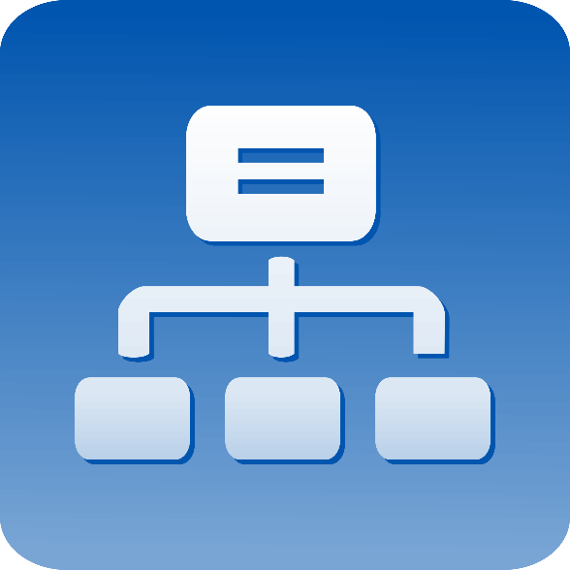
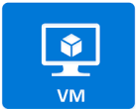
CLUSTERS
Azure Databricks clusters are the set of Azure Linux VMs that host the Spark Worker and Driver Nodes
Your Spark application code (i.e. Jobs) runs on the provisioned clusters.
Azure Databricks clusters are launched in your subscription—but are managed through the Azure Databricks portal.
Azure Databricks provides a comprehensive set of graphical wizards to manage the complete lifecycle of clusters—from creation to termination.

Slide 26
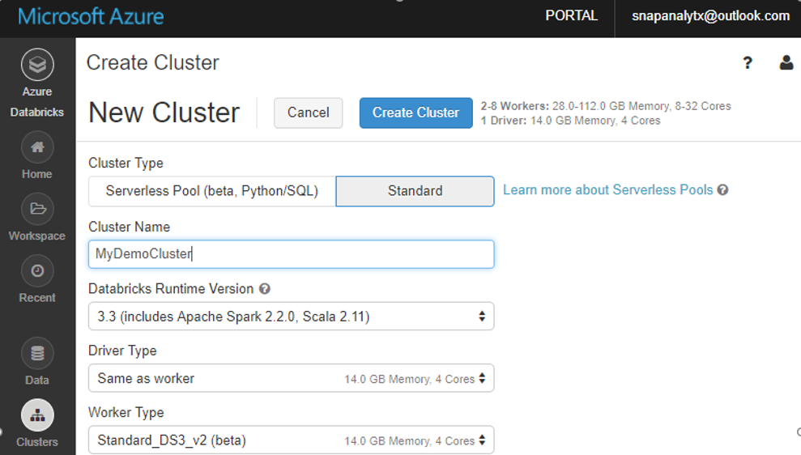
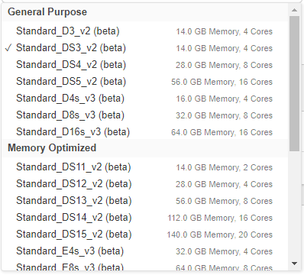
CLUSTER CREATION
You can create two types of clusters – Standard and Serverless Pool (see next slide)
While creating a cluster you can specify:
Number of nodes
Autoscaling and Auto Termination policy
Auto Termination policy
Spark Configuration details
The Azure VM instance types for the Driver and Worker Nodes
Graphical wizard in the Azure Databricks portal to create a Standard Cluster

Slide 27
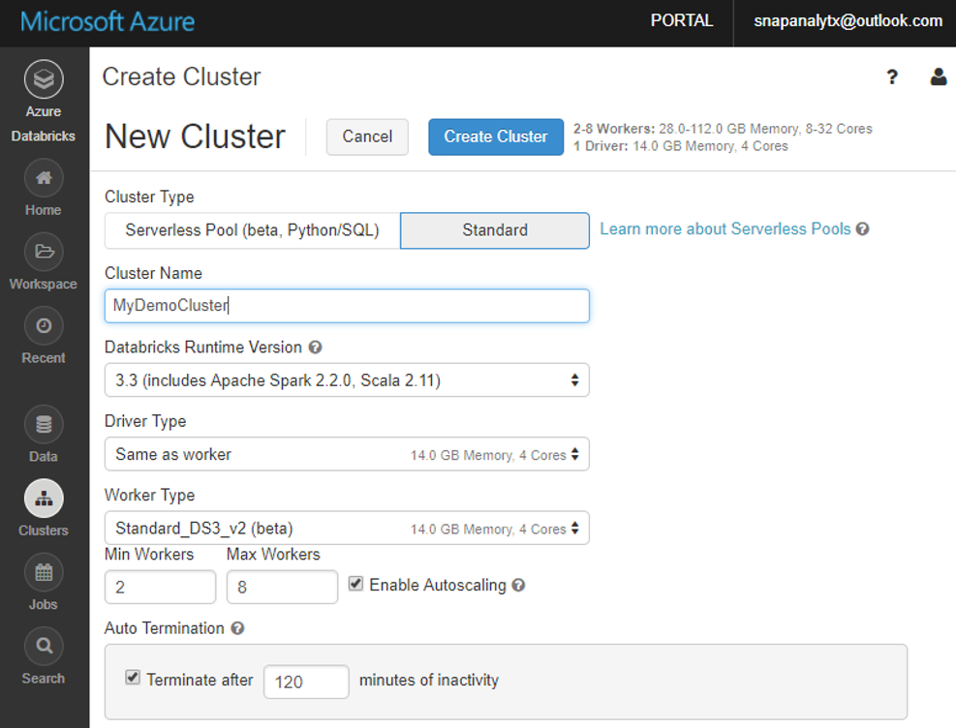
CLUSTERS: AUTO SCALING AND AUTO TERMINATION
Simplifies cluster management and reduces costs by eliminating wastage
When creating Azure Databricks clusters you can choose Autoscaling and Auto Termination options.
Autoscaling: Just specify the min and max number of clusters. Azure Databricks automatically scales up or down based on load.
Auto Termination: After the specified minutes of inactivity the cluster is automatically terminated.
Benefits:
You do not have to guess, or determine by trial and error, the correct number of nodes for the cluster
As the workload changes you do not have to manually tweak the number of nodes
You do not have to worry about wasting resources when the cluster is idle. You only pay for resource when they are actually being used
You do not have to wait and watch for jobs to complete just so you can shutdown the clusters

Slide 28
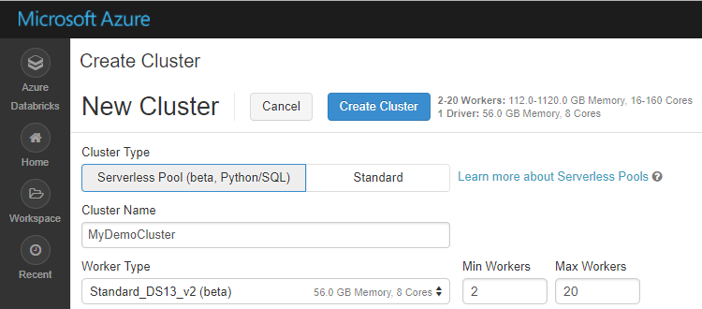
SERVERLESS POOL (BETA)
A self-managed pool of cloud resources, auto-configured for interactive Spark workloads
You specify only the minimum and maximum number of nodes in the cluster—Azure Databricks provisions and adjusts the compute and local storage based on your usage.
Limitation: Currently works only for SQL and Python.
Benefits of Serverless Pool
Auto-Configuration | Databricks chooses the best configuration for Spark to get the best performance Users don’t need to worry about providing any of the Databricks runtime version or Spark configuration. Databricks also chooses the best cluster parameters to save cost on infrastructure
Elasticity | Automatically scales the compute and local storage, independently, based on usage
Fine grained Sharing | Offers maximum resource utilization and minimum query latencies Preemption: Databricks proactively preempts Spark tasks from over-committed users to ensure all users get their fair share of cluster time and their jobs complete in a timely manner even when contending with dozens of other users. Uses the “Task Preemption for High Concurrency” feature of Spark in Databricks. Fault isolation: Databricks sandboxes the environments belonging to different notebooks from one another.

Slide 29
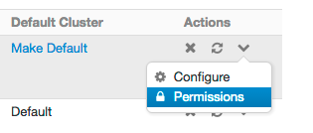
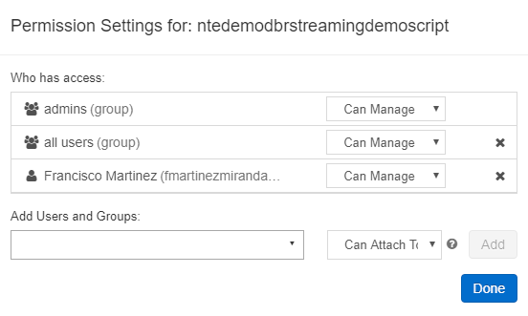
CLUSTER ACCESS CONTROL
There are two configurable types of permissions for Cluster Access Control:
Individual Cluster Permissions - This controls a user’s ability to attach notebooks to a cluster, as well as to restart/resize/terminate/start clusters.
Cluster Creation Permissions - This controls a user’s ability to create clusters
Individual permissions can be configured on the Clusters Page by clicking on Permissions under the ‘More Actions’ icon of an existing cluster
There are 4 different individual cluster permission levels: No Permissions, Can Attach To, Can Restart, and Can Manage. Privileges are shown below
Abilities | No Permissions | Can Attach To | Can Restart | Can Manage
Attach notebooks to cluster |  | x | x | x
View Spark UI |  | x | x | x
View cluster metrics (Ganglia) |  | x | x | x
Terminate cluster |  |  | x | x
Start cluster |  |  | x | x
Restart cluster |  |  | x | x
Resize cluster |  |  |  | x
Modify permissions |  |  |  | x
Tom Smith (tom@company.com)

Slide 30
Jobs

Slide 31

JOBS
Jobs are the mechanism to submit Spark application code for execution on the Databricks clusters
Spark application code is submitted as a ‘Job’ for execution on Azure Databricks clusters
Jobs execute either ‘Notebooks’ or ‘Jars’
Azure Databricks provide a comprehensive set of graphical tools to create, manage and monitor Jobs.

Slide 32
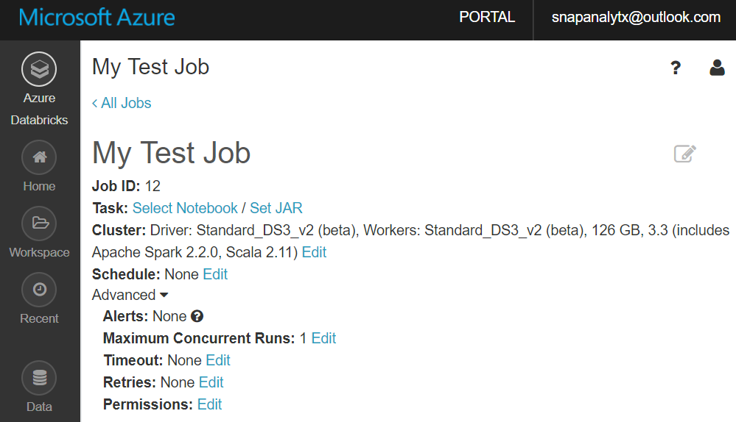
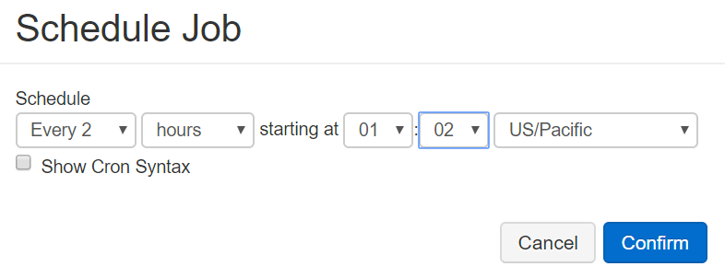
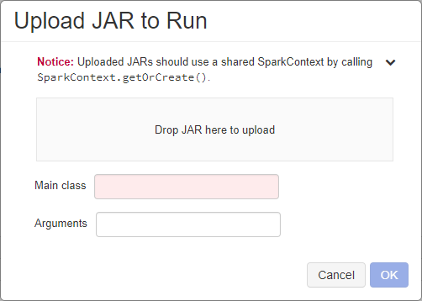
CREATING AND RUNNING JOBS (1 OF 2)
When you create a new Job you have to specify:
The Notebook or Jar to execute
Cluster: The cluster on which the Job execute. This could be an exiting or new cluster.
Schedule i.e. how often the Job runs. Jobs can also be run one time right away.

Slide 33
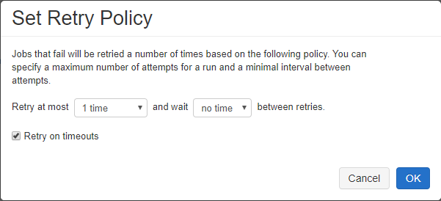
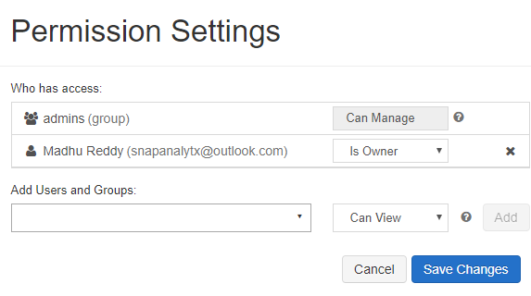
CREATING AND RUNNING JOBS (2 OF 2)
When you create a new job you can optionally specify advanced options:
Maximum number of concurrent runs of the Job
Timeout: Jobs still running beyond the specified duration are automatically killed
Retry Policy: Specifies if—and when—failed jobs will be retried
Permissions: Who can do what with jobs. This allows for Job definition and management to be securely shared with others (see next slide)

Slide 34
JOB ACCESS CONTROL
Enables job owners and administrators to grant fine grained permissions on their jobs
Abilities | No Permissions | Can View | Can Manage Run | Is Owner | Can Manage (admin)
View job details and settings | Yes | Yes | Yes | Yes | Yes
View results, Spark UI, logs of a job run |  | Yes | Yes | Yes | Yes
Run now |  |  | Yes | Yes | Yes
Cancel run |  |  | Yes | Yes | Yes
Edit job settings |  |  |  | Yes | Yes
Modify permissions |  |  |  | Yes | Yes
Delete job |  |  |  | Yes | Yes
Change owner |  |  |  |  | Yes
With Jobs Access Controls job owners can choose which other users or groups can view results of the job.
Owners can also choose who can manage runs of their job (i.e. invoke run now and cancel.)
There are 5 different permission levels for jobs:
No Permissions
Can View
Can Manage Run
Is Owner and
Can Manage
Note: ‘Can Manage’ permission is reserved for administrators.
Notes:
The Databricks job scheduler, like the Spark batch interface, is not intended for low latency jobs. Due to network or cloud issues, job runs may occasionally be delayed up to several minutes. In these situations, scheduled jobs will fire immediately upon service availability.

Slide 35
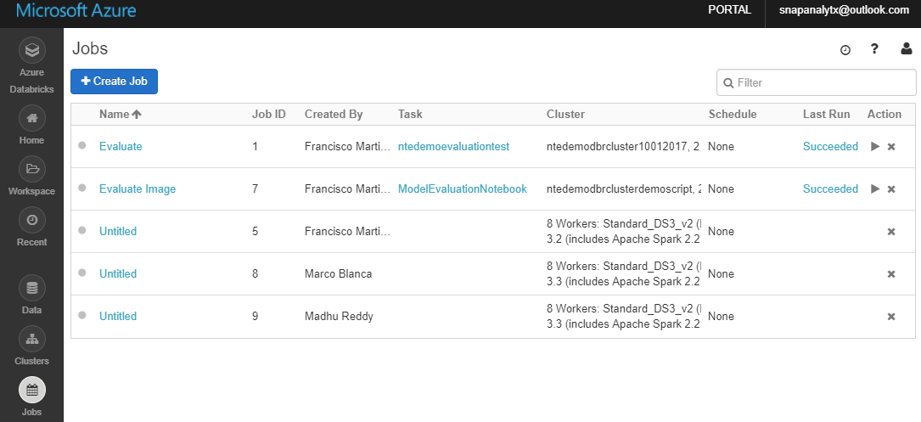
VIEWING LIST OF JOBS
In the Portal you can view the list of all jobs you have access to
You can click on “Run Now” icon to run the job right away
You can also delete a job from the list
Joe Smith
Joe Smith
Joe Smith
Joe Smith
Joe Smith
Notes:
Databricks maintains a history of your job runs for up to 60 days. If you need to preserve job runs, we recommend you to save job run results through the UI before they expire.

Slide 36
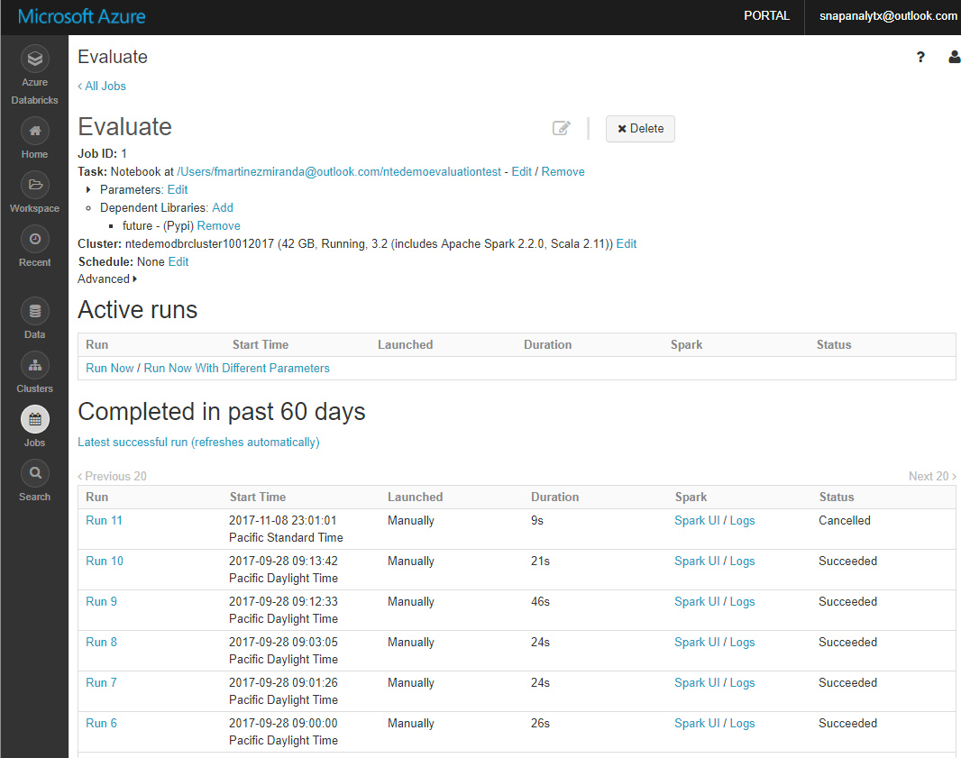
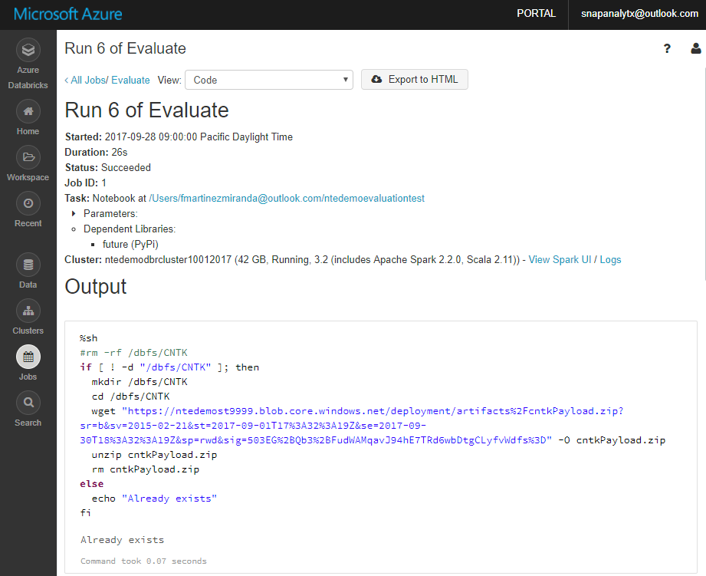
VIEWING JOBS HISTORY
In the Azure Databricks Jobs Portal you can view:
The list of currently running (Active) Jobs
History of old Job runs (for up to 60 days)
The output of a particular Job run (including standard error, standard output, Spark UI logs)
Notes:
Databricks maintains a history of your job runs for up to 60 days. If you need to preserve job runs, we recommend you to save job run results through the UI before they expire.

Slide 37
Workspaces & Folders

Slide 38
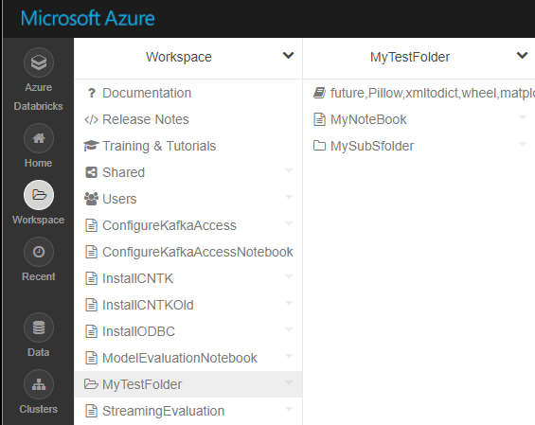
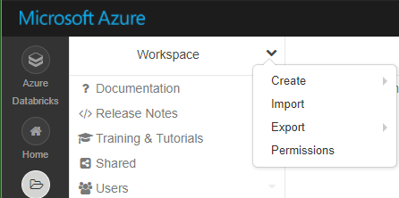
WORKSPACES
Workspaces enables users to organize—and share—their Notebooks, Libraries and Dashboards
Workspaces—sort of like Directories— are a convenient way to organize an user’s Notebook, Libraries and Dashboards.
Everything in a workspace is organized into hierarchical folders. Folders can hold Libraries, Notebooks, Dashboard or more (sub) folders.
Icons indicate the type of the object contained in a folder
Every user has one directory that is private and unshared.
By default, the workspace and all its contents are available to users.
Fine grained access control can be defined on workspaces (next slide) to enable secure collaboration with colleagues.

Slide 39
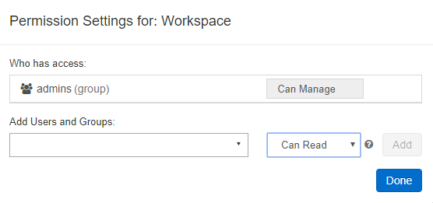
WORKSPACE OPERATIONS
You can search the entire Databricks workspace
In the Azure Databricks Portal, via the Workspaces drop down menu, you can:
Create Folders, Notebooks and Libraries
Import Notebooks into the Workspace
Export the Workspace to a database archive
Set Permissions. You can grant 4 levels of permissions
Can Manage
Can Read
Can Edit
Can Run

Slide 40
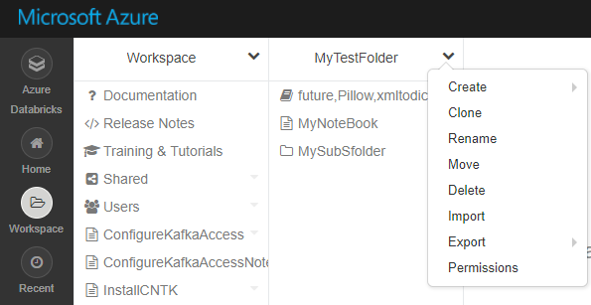
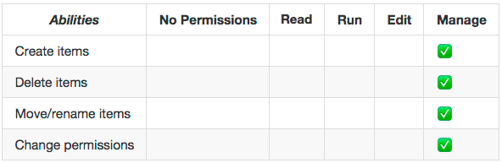
FOLDER OPERATIONS AND ACCESS CONTROL
In the Azure Databricks Portal, via the Folder drop down menu, you can:
Create Folders, Notebooks and Libraries within the folder
Clone the folder to create a deep copy of the folder
Rename or delete the folder
Move the folder to another location
Export a folder to save it and its contents as a Databricks archive
Import a saved Databricks archive into the selected folder
Set Permissions for the folder. As with Workspaces you can set 5 levels of permissions: No Permissions, Can Manage, Can Read, Can Edit, Can Run
Abilities associated with each permission level

Slide 41
Notebooks, Libraries, Visualization

Slide 42
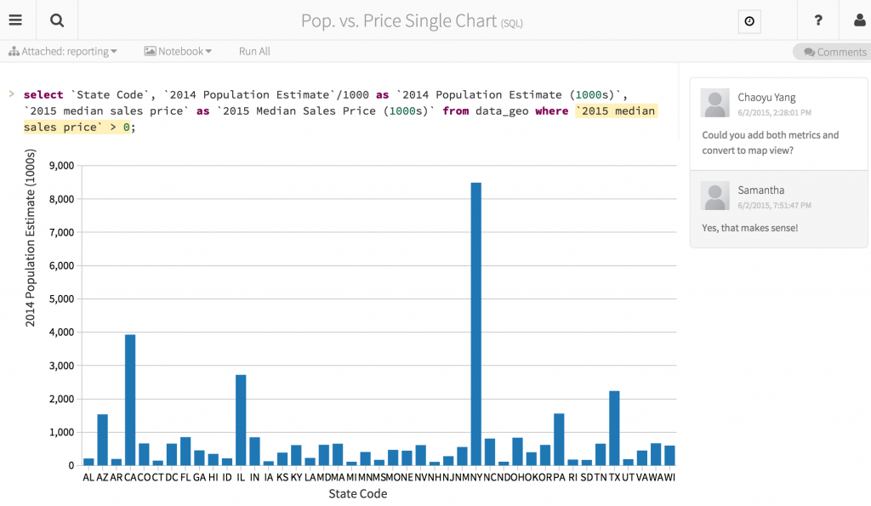
AZURE DATABRICKS NOTEBOOKS OVERVIEW
Notebooks are a popular way to develop, and run, Spark Applications
Notebooks are not only for authoring Spark applications but can be run/executed directly on clusters
Shift+Enter
click the at the top right of the cell in a notebook
Submit via Job
Notebooks support fine grained permissions—so they can be securely shared with colleagues for collaboration (see following slide for details on permissions and abilities)
Notebooks are well-suited for prototyping, rapid development, exploration, discovery and iterative development
Notebooks typically consist of code, data, visualization, comments and notes

Slide 43
MIXING LANGUAGES IN NOTEBOOKS
You can mix multiple languages in the same notebook
Normally a notebook is associated with a specific language. However, with Azure Databricks notebooks, you can mix multiple languages in the same notebook. This is done using the language magic command:
%python Allows you to execute python code in a notebook (even if that notebook is not python)
%sql Allows you to execute sql code in a notebook (even if that notebook is not sql).
%r Allows you to execute r code in a notebook (even if that notebook is not r).
%scala Allows you to execute scala code in a notebook (even if that notebook is not scala).
%sh Allows you to execute shell code in your notebook.
%fs Allows you to use Databricks Utilities - dbutils filesystem commands.
%md To include rendered markdown
Notes:
Note that %run lets you run one notebook from within another
Scala and Python notebooks support error highlighting
Tabular result output can be downloaded to local machine
Notebooks track revision history to support collaboration

Slide 44
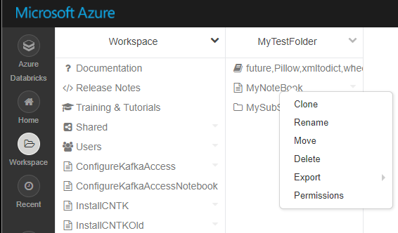
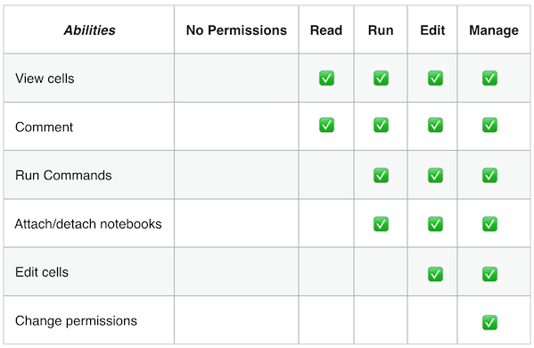
NOTEBOOK OPERATIONS AND ACCESS CONTROL
You can create a new notebook from the Workspace or the folder drop down menu (see previous slides)
From a notebook’s drop down menu you can:
Clone the notebook
Rename or delete the notebook
Move the notebook to another location
Export a notebook to save it and its contents as a Databricks archive or IPython notebook or HTML or source code file.
Set Permissions for the notebook As with Workspaces you can set 5 levels of permissions: No Permissions, Can Manage, Can Read, Can Edit, Can Run
You can also set permissions from notebook UI itself by selecting the menu option.
Abilities associated with each permission level

Slide 45
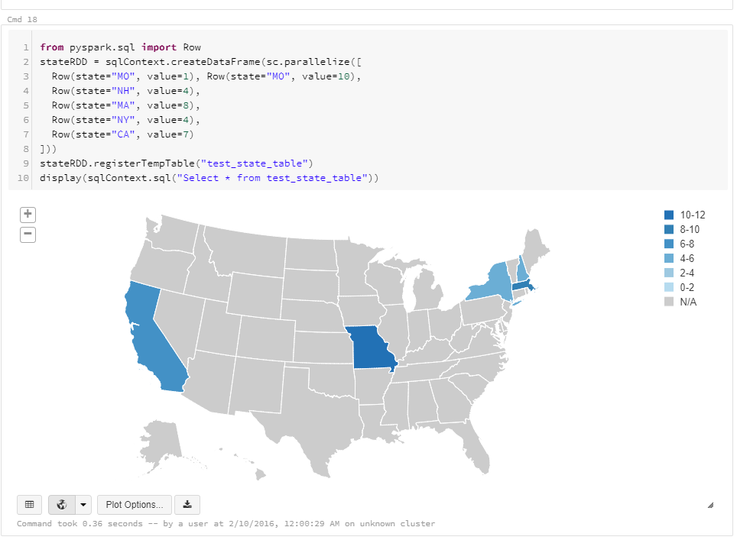
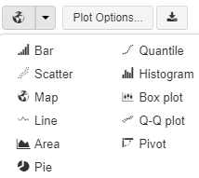
VISUALIZATION
Azure Databricks supports a number of visualization plots out of the box
All notebooks, regardless of their language, support Databricks visualizations.
When you run the notebook the visualizations are rendered inside the notebook in-place
The visualizations are written in HTML.
You can save the HTML of the entire notebook by exporting to HTML.
If you use Matplotlib, the plots are rendered as images so you can just right click and download the image
You can change the plot type just by picking from the selection
Notes:
Additionally, all Azure Databricks programming language notebooks (python, scala, R) support using interactive HTML graphics using javascript libraries like D3.
To use this, you can pass any HTML, CSS, or JavaScript code to the displayHTML() function to render its results.
You can display MatPlotLib and ggplot objects in Python notebooks
You can use Plotly, an interactive graphing library
Azure Databricks supports htmlwidgets. With R htmlwidgets you can generate interactive plots using R’s flexible syntax and environment.

Slide 46
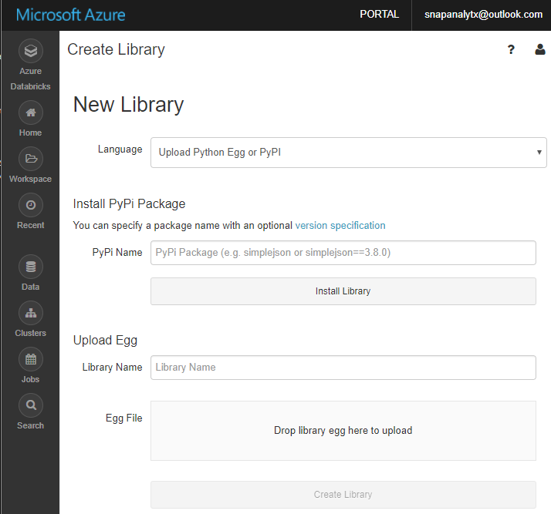
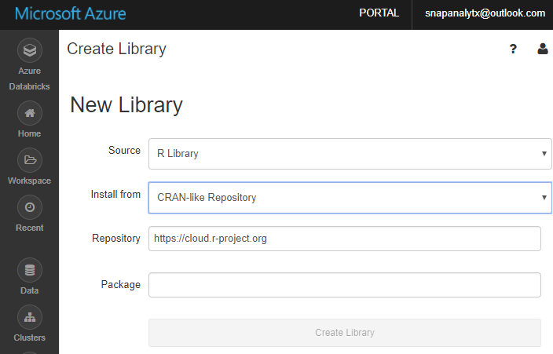
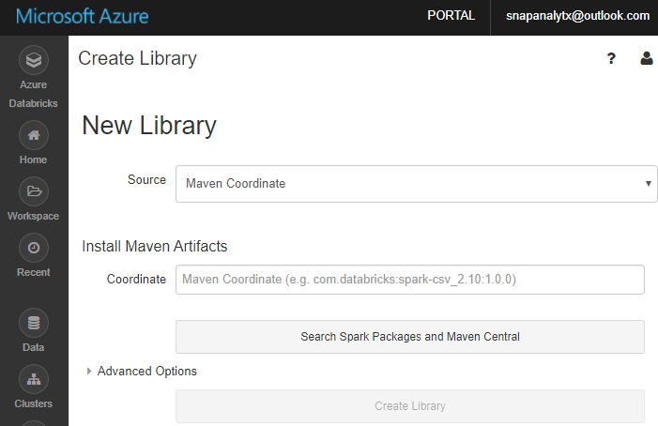
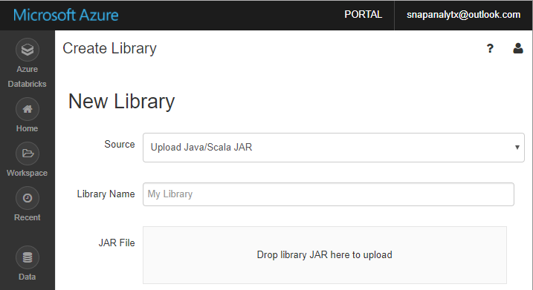
LIBRARIES OVERVIEW
Enables external code to be imported and stored into a Workspace
Libraries are containers to hold all your Python, R, Java/Scala libraries.
Libraries resides within workspaces or folders.
Libraries are created by importing the source code
After importing libraries are immutable—can be deleted or overwritten only.
You can customize installation of libraries via Init Scripts by writing custom UNIX scripts
Libraries can also be managed via the Library API

Slide 47
DATABRICKS FILE SYSTEM (DBFS)
Is a distributed File System (DBFS) that is a layer over Azure Blob Storage
Python
Scala
CLI
dbutils
Azure Storage buckets can be mounted in DBFS so that users can directly access them without specifying the storage keys
DBFS mounts are created using dbutils.fs.mount()
Azure Storage data can be cached locally on the SSD of the worker nodes
Available in both Python and Scala and accessible via a DBFS CLI
Data persist in Azure Blob Storage – is not lost even after cluster termination
Comes pre-installed on Spark clusters in Databricks
DBFS
db.fs.mount()
db.fs.mount()
Azure Blob Storage

Slide 48
Azure Databricks Performance

Slide 49
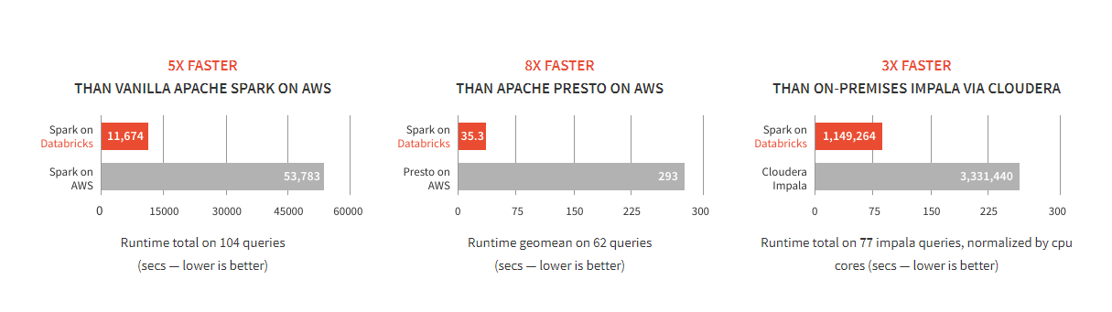
DATABRICKS SPARK IS FAST
Benchmarks have shown Databricks to often have better performance than alternatives
SOURCE: Benchmarking Big Data SQL Platforms in the Cloud

Slide 50

WHAT MAKES SPARK FAST?( 1OF 2)
In-memory cluster computing: Spark provides primitives for in-memory cluster computing. A Spark job can load and cache data into memory and query it repeatedly (iteratively) much quicker than disk-based systems.
Scala Integration: Spark integrates into the Scala programming language, letting you manipulate distributed datasets like local collections. No need to structure everything as map and reduce operations
Faster Data-sharing: Data-sharing between operations is faster as data is in-memory:
In (traditional) Hadoop data is shared through HDFS which is expensive. HDFS maintains three replicas.
Spark stores data in-memory without any replication.
Data Sharing between Steps of a Job
Read from HDFS
Write to HDFS
Read from HDFS
Write to HDFS
In Traditional MapReduce
Step 1
Step 2
Read from HDFS
In Spark
Step 1
Step 2

Slide 51
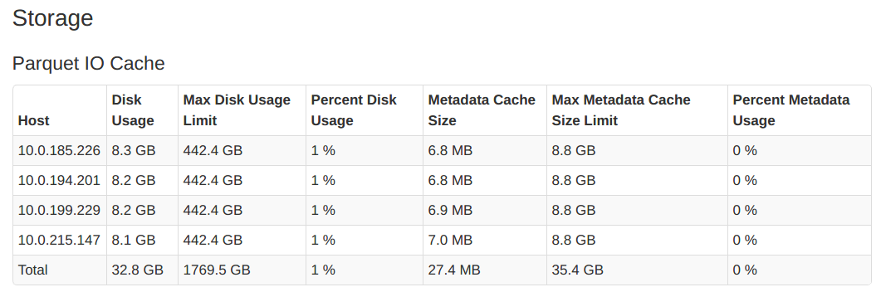
WHAT MAKES SPARK FAST? (2 OF 2)
Databricks IO Cache automatically caches ‘remote’ data on ‘local nodes’ to accelerate data reads
A copy of the remote file is created in the node’s local storage
Local data is stored in a fast intermediate format
Currently Parquet file format is supported
Remote data is cached automatically
Supports DBFS, HDFS, Azure Blob Storage and Azure Data Lake store
DBIO Cache lets you”
Enable or disable caching at anytime
Cache only a select subset of the data
DBIO Cache has to be configured during cluster creation. The ‘max disk space per node reserved for cached data’ must be specified during cluster creation
You can Monitor the state of the DBIO cache in the Portal

Slide 52
RDDS AND DBIO CACHE - DIFFERENCES
DBIO cache and RDDs are both caches that can be used together
Capability | Comment
Availability | RDD is part of Apache Spark Databricks IO cache is available only to Databricks customers.
Type of data stored | The RDD cache can be used to store the result of any subquery. The DBIO cache is designed to speed-up scans by creating local copies of remote data. It can improve the performance of a wide range of queries, but cannot be used to store results of arbitrary subqueries.
Performance | The data stored in the DBIO cache can be read and operated on faster than the data in the RDD cache. This is because the DBIO cache uses efficient decompression algorithms, and outputs data in the optimal format for further processing using whole-stage code generation.
Automatic vs manual control | When using the RDD cache it is necessary to manually choose tables or queries to be cached. When using the DBIO cache the data is added to the cache automatically whenever it has to be fetched from a remote source. This process is fully transparent and does not require any action from the user.
Disk vs memory-based | Unlike the RDD cache, the DBIO cache is stored entirely on the local disk.
Notes:
Tip:
Use the RDD cache for storing the results of manually chosen subqueries.
Use the DBIO cache to automatically improve the scan performance in workflows reading Parquet files.
Configuration: The DBIO cache has to be configured during cluster creation with the following settings:
spark.Databricks.io.cache.maxDiskUsage "{DISK SPACE PER NODE RESERVED FOR CACHED DATA}" spark.Databricks.io.cache.maxMetaDataCache "{DISK SPACE PER NODE RESERVED FOR CACHED METADATA}"
As a guideline, we recommend using the following values:
For spark.Databricks.io.cache.maxDiskUsage: use 50% of the total available storage space per node
For spark.Databricks.io.cache.maxMetaDataCache: use 2% of the space dedicated to spark.Databricks.io.cache.maxDiskUsage
It is possible to explicitly select a subset of data to be cached using following syntax
CACHE SELECT column_name[, column_name, ...] FROM [db_name.]table_name [ WHERE boolean_expression ]

Slide 53
Data Analytics

Slide 54
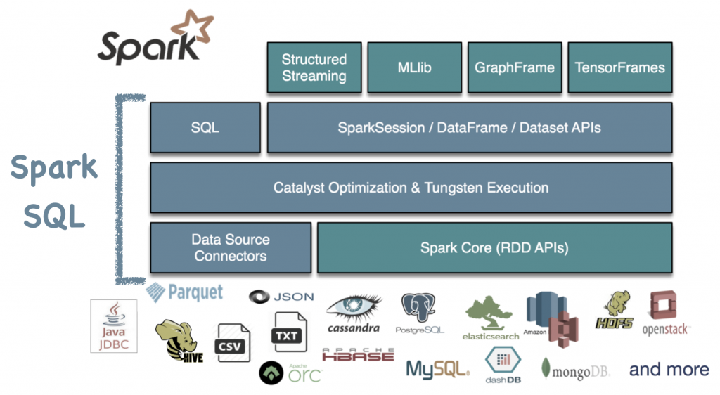
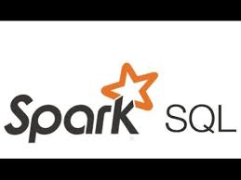
SPARK SQL OVERVIEW
Spark SQL is a distributed SQL query engine for processing structured data
Can query data stored in wide variety of data sources—external databases, structured data files, Hive tables and more.
Data can be queried using either SQL or HiveQL
Has bindings in Python, Scala and Java
Has built-in support for structured streaming.
Built using the Catalyst optimizer and Tungsten execution
Notes:
Diagram from Databricks

Slide 55
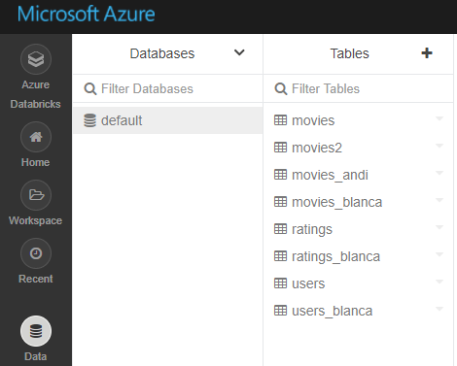
DATABASES AND TABLES OVERVIEW
Tables enable data to be structured and queried using Spark SQL or any of the Spark’s language APIs
Databases are a collection of related tables
Tables are defined using the GUI in the console or programmatically using APIs or Notebooks
Databricks uses the Hive metastore to manage tables, and supports all file formats and Hive data sources.
There are multiple ways to create tables (see next slide).
Like Apache Spark DataFrames, any Spark operation can be applied to Tables (including caching, filtering).
Partitioned Tables and Partition Pruning: Spark SQL is able to dynamically generate partitions at the file storage level to provide partition columns for tables. When the table is scanned, Spark pushes down the filter predicates involving the partitionBy keys for partition pruning.
Notes:
Managed and Unmanaged Tables
Every Spark-SQL table has a metadata information that stores the schema and the data itself.
Managed tables are Spark SQL tables where Spark manages both the data and the metadata. Since Spark SQL manages the tables, doing a DROP TABLE example_data will delete both the metadata and data automatically.
Unmanaged tables: Here Spark SQL manages the metadata and you control the data’s location. Spark SQL will just manage the relevant metadata, so when you perform DROP TABLE example_data, Spark will only remove the metadata and not the data itself. The data will still be present in the path you provided. Note you can also create an unmanaged table with your data in other data sources like Cassandra, JDBC table, etc.

Slide 56
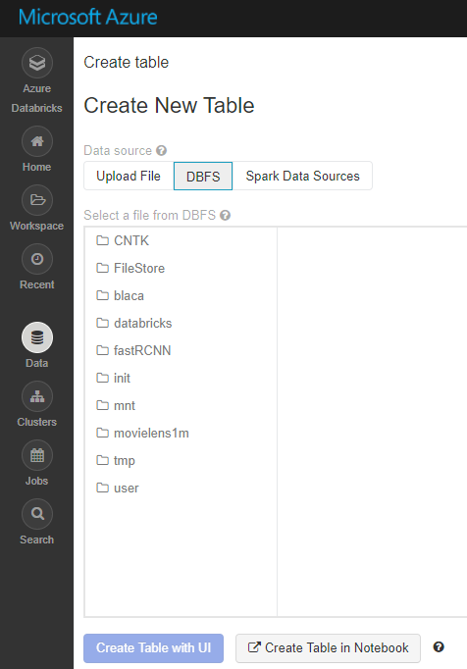
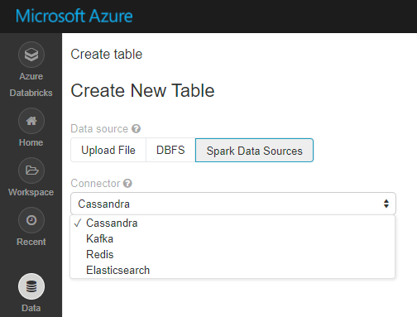
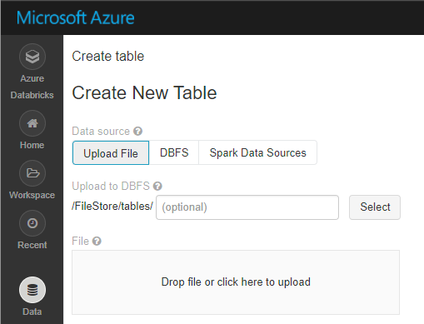
WAYS TO CREATE TABLES
From Spark Data Sources
From local files (in CSV, JSON or Avro formats)
From data in DBFS
Note: You can also create tables programmatically (CREATE TABLE tablename …)
Notes:
When creating tables from DBFS
Databricks will not read data from a table created from storage until a user accesses it.
If you change the data in the storage directory, the table will reflect the new data

Slide 57
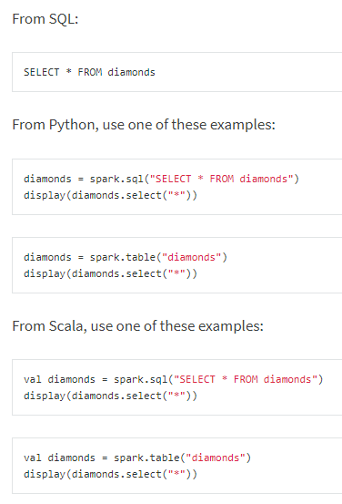
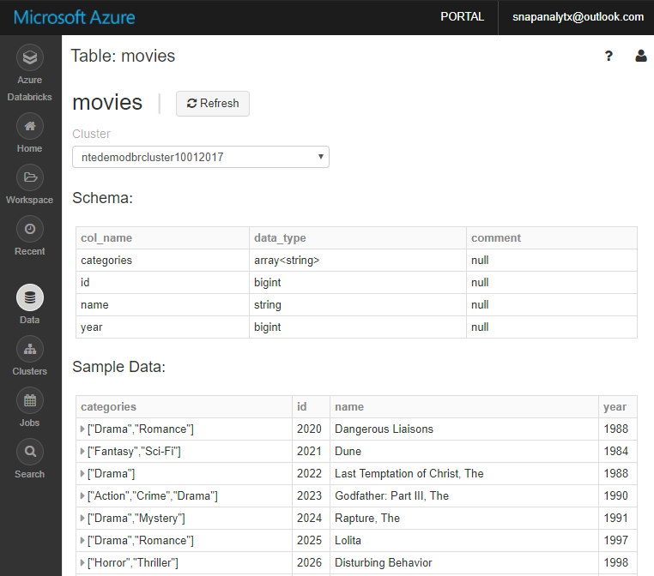
TABLE OPERATIONS
Azure Databricks tables support the following operations
Listing database and tables
Viewing table details including its schema and sample data
Reading from tables
Updating tables: Table schema is immutable. However, a user can update table data by changing the underlying files.
Deleting tables: A user can delete tables either through the UI or programmatically

Slide 58
LOCAL AND GLOBAL TABLES
Azure Databricks Tables
Global Tables
Local Tables
Databricks registers global tables to the Hive metastore and makes them available across all clusters.
Only global tables are visible in the Tables pane
Databricks does not registers local tables in the Hive metastore and are only available within one cluster.
Also known as temporary tables

Slide 59
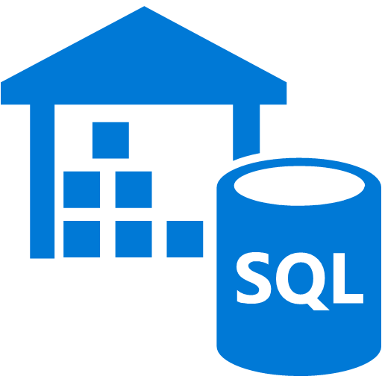


AZURE SQL DW INTEGRATION
Integration enables structured data from SQL DW to be included in Spark Analytics
Azure SQL Data Warehouse is a SQL-based fully managed, petabyte-scale cloud solution for data warehousing
You can bring in data from Azure SQL DW to perform advanced analytics that require both structured and unstructured data.
Currently you can access data in Azure SQL DW via the JDBC driver. From within your spark code you can access just like any other JDBC data source.
If Azure SQL DW is authenticated via AAD then Azure Databricks user can seamlessly access Azure SQL DW.
Azure Databricks
Azure SQL DW

Slide 60



POWER BI INTEGRATION
Enables powerful visualization of data in Spark with Power BI
Power BI is a business analytics tool that provides data Visualization, Report and Dashboard throughout an organization
Power BI Desktop can connect to Azure Databricks clusters to query data using JDBC/ODBC server that runs on the driver node.
This server listens on port 10000 and it is not accessible outside the subnet where the cluster is running.
Azure Databricks uses a public HTTPS gateway
The JDBC/ODBC connection information can be obtained from the Cluster UI directly as shown in the figure.
When establishing the connection, you can use a Personal Access Token to authenticate to the cluster gateway. Only users who have attach permissions can access the cluster via the JDBC/ ODBC endpoint.
In Power BI desktop you can setup the connection by choosing the ODBC data source in the “Get Data” option.

Slide 61


COSMOS DB INTEGRATION
The Spark connector enables real-time analytics over globally distributed data in Azure Cosmos DB
Azure Cosmos DB is Microsoft's globally distributed, multi-model database service for mission-critical applications
With Spark connector for Azure Cosmos DB, Apache Spark can now interact with all Azure Cosmos DB data models: Documents, Tables, and Graphs.
efficiently exploits the native Azure Cosmos DB managed indexes and enables updateable columns when performing analytics.
utilizes push-down predicate filtering against fast-changing globally-distributed data
Some use-cases for Azure Cosmos DB + Spark include:
Streaming Extract, Transformation, and Loading of data (ETL)
Data enrichment
Trigger event detection
Complex session analysis and personalization
Visual data exploration and interactive analysis
Notebook experience for data exploration, information sharing, and collaboration
The connector uses the Azure DocumentDB Java SDK and moves data directly between Spark worker nodes and Cosmos DB data nodes

Slide 62
AZURE BLOB STORAGE INTEGRATION
Data can be read from Azure Blob Storage using the Hadoop FileSystem interface. Data can be read from public storage accounts without any additional settings. To read data from a private storage account, you need to set an account key or a Shared Access Signature (SAS) in your notebook
Setting up an account key
spark.conf.set ( "fs.azure.account.key.{Your Storage Account Name}.blob.core.windows.net", "{Your Storage Account Access Key}")
Setting up a SAS for a given container:
spark.conf.set( "fs.azure.sas.{Your Container Name}.{Your Storage Account Name}.blob.core.windows.net", "{Your SAS For The Given Container}")
Once an account key or a SAS is setup, you can use standard Spark and Databricks APIs to read from the storage account:
val df = spark.read.parquet("wasbs://{Your Container Name}@m{Your Storage Account name}.blob.core.windows.net/{Your Directory Name}")
dbutils.fs.ls("wasbs://{Your ntainer Name}@{Your Storage Account Name}.blob.core.windows.net/{Your Directory Name}")

Slide 63
AZURE DATA LAKE INTEGRATION
To read from your Data Lake Store account, you can configure Spark to use service credentials with the following snippet in your notebook
spark.conf.set("dfs.adls.oauth2.access.token.provider.type", "ClientCredential")
spark.conf.set("dfs.adls.oauth2.client.id", "{YOUR SERVICE CLIENT ID}")
spark.conf.set("dfs.adls.oauth2.credential", "{YOUR SERVICE CREDENTIALS}")
spark.conf.set("dfs.adls.oauth2.refresh.url", "https://login.windows.net/{YOUR DIRECTORY ID}/oauth2/token")
After providing credentials, you can read from Data Lake Store using standard APIs:
val df = spark.read.parquet("adl://{YOUR DATA LAKE STORE ACCOUNT NAME}.azuredatalakestore.net/{YOUR DIRECTORY NAME}")
dbutils.fs.list("adl://{YOUR DATA LAKE STORE ACCOUNT NAME}.azuredatalakestore.net/{YOUR DIRECTORY NAME}")

Slide 64
Machine Learning and Deep Learning

Slide 65

SPARK MACHINE LEARNING(ML) OVERVIEW
Enables Parallel, Distributed ML for large datasets on Spark Clusters
Offers a set of parallelized machine learning algorithms (see next slide)
Supports Model Selection (hyperparameter tuning) using Cross Validation and Train-Validation Split.
Supports Java, Scala or Python apps using DataFrame-based API (as of Spark 2.0). Benefits include:
An uniform API across ML algorithms and across multiple languages
Facilitates ML pipelines (enables combining multiple algorithms into a single pipeline).
Optimizations through Tungsten and Catalyst
Spark MLlib comes pre-installed on Azure Databricks
3rd Party libraries supported include: H20 Sparkling Water, SciKit-learn and XGBoost

Slide 66

MMLSPARK
Microsoft Machine Learning Library for Apache Spark (MMLSpark) lets you easily create scalable machine learning models for large datasets.
It includes integration of SparkML pipelines with the Microsoft Cognitive Toolkit and OpenCV, enabling you to:
Ingress and pre-process image data
Featurize images and text using pre-trained deep learning models
Train and score classification and regression models using implicit featurization

Slide 67
SPARK ML ALGORITHMS
Classification and Regression | Linear Models (SVMs, logistic regression, linear regression) Naïve Bayes Decision Trees Ensembles of trees (Random Forest, Gradient-Boosted Trees) Isotonic regression
Clustering | k-means and streaming k-means Gaussian mixture Power iteration clustering (PIC) Latent Dirichlet allocation (LDA)
Collaborative Filtering | Alternating least squares (ALS)
Dimensionality Reduction | SVD PCA
Frequent Pattern Mining | FP-growth Association rules
Basic Statistics | Summary statistics Correlations Stratified sampling Hypothesis testing Random data generation
Spark ML Algorithms

Slide 68


DEEP LEARNING
Azure Databricks supports and integrates with a number of Deep Learning libraries and frameworks to make it easy to build and deploy Deep Learning applications
Supports Deep Learning Libraries/frameworks including:
Microsoft Cognitive Toolkit (CNTK).
Article explains how to install CNTK on Azure Databricks.
TensorFlowOnSpark
BigDL
Offers Spark Deep Learning Pipelines, a suite of tools for working with and processing images using deep learning using transfer learning. It includes high-level APIs for common aspects of deep learning so they can be done efficiently in a few lines of code:
Image loading
Applying pre-trained models as transformers in a Spark ML pipeline
Transfer learning
Distributed hyperparameter tuning
Deploying models in DataFrames and SQL
Distributed Hyperparameter Tuning
Transfer Learning

Slide 69

SPARKR OVERVIEW
An R package that provides a light-weight frontend to use Apache Spark from R
Provides a distributed DataFrame implementation that supports operations like selection, filtering, aggregation etc (similar to R data frames, dplyr)
Supports distributed machine learning using Spark MLlib.
R programs can connect to a Spark cluster from RStudio, R shell, Rscript or other R IDEs.
Local
Workers
Spark
Executor
Exec
Spark
Context
R-JVM bridge
Java Spark Context
Spark
Executor
Exec

Slide 70
Stream Analytics & Graph Processing

Slide 71


SPARK STRUCTURED STREAMING OVERVIEW
A unified system for end-to-end fault-tolerant, exactly-once stateful stream processing
Unifies streaming, interactive and batch queries—a single API for both static bounded data and streaming unbounded data.
Runs on Spark SQL. Uses the Spark SQL Dataset/DataFrame API used for batch processing of static data.
Runs incrementally and continuously and updates the results as data streams in.
Supports app development in Scala, Java, Python and R.
Supports streaming aggregations, event-time windows, windowed grouped aggregation, stream-to-batch joins.
Features streaming deduplication, multiple output modes and APIs for managing/monitoring streaming queries.
Built-in sources: Kafka, File source (json, csv, text, parquet)
Notes:
Addresses many of the pain points with DStreams.
Enables the development o f “Continuous Applications” that need to interact with batch data, interactive analysis, ML etc.

Slide 72



APACHE KAFKA FOR HDINSIGHT INTEGRATION
Azure Databricks Structured Streaming integrates with Apache Kafka for HDInsight
Apache Kafka for Azure HDInsight is an enterprise grade streaming ingestion service running in Azure.
Azure Databricks Structured Streaming applications can use Apache Kafka for HDInsight as a data source or sink.
No additional software (gateways or connectors) are required.
Setup: Apache Kafka on HDInsight does not provide access to the Kafka brokers over the public internet. So the Kafka clusters and the Azure Databricks cluster must be located in the same Azure Virtual Network.
Kafka App
Spark App
Azure Databricks
Note: Azure Databricks Structured Streaming integration with Azure Event Hubs is forthcoming

Slide 73

SPARK GRAPHX OVERVIEW
A set of APIs for graph and graph-parallel computation.
Unifies ETL, exploratory analysis, and iterative graph computation within a single system.
Developers can:
view the same data as both graphs and collections,
transform and join graphs with RDDs, and
write custom iterative graph algorithms using the Pregel API.
Currently only supports using the Scala and RDD APIs.
Algorithms
PageRank Benchmark
PageRank
Connected components
Label propagation
SVD++
Strongly connected components
Triangle count
Source: AMPLab
Notes:
This article claims that Facebook found in their benchmarks that GraphX was not as performant as Giraph. See https://code.facebook.com/posts/319004238457019/a-comparison-of-state-of-the-art-graph-processing-systems/

Slide 74
CLI and REST APIs

Slide 75
DATABRICKS CLI
An easy to use interface built on top of the Databricks REST API
Databricks CLI
Workspace
CLI
DBFS CLI
Currently, the CLI fully implements the DBFS API and the Workspace API
Notes:
Setting Up Authentication
There are two ways to authenticate to Databricks. The first way is to use your username and password pair. To do this run Databricks configure and follow the prompts. The second and recommended way is to use an access token generated from Databricks. To configure the CLI to use the access token run Databricks configure --token. After following the prompts, your access credentials will be stored in the file ~/.Databricks.

Slide 76
DATABRICKS WORKSPACE CLI
delete | Deletes objects from the Databricks...
export | Exports a file from the Databricks workspace...
export_dir | Recursively exports a directory from the...
import | Imports a file from local to the Databricks...
import-dir | Recursively imports a directory from local to...
list / ls | List objects in the Databricks Workspace
mkdirs | Make directories in the Databricks Workspace
rm | Deletes objects from the Databricks...
Databricks Workspace CLI Commands
Workspace CLI Example
$ Databricks workspace ls /Users/example@Databricks.com/example -l
NOTEBOOK a PYTHON
NOTEBOOK b SCALA
NOTEBOOK c SQL
NOTEBOOK d R
DIRECTORY e

Slide 77
DBFS CLI
Leverages the DBFS API to provide an easy Command Line Interface to DBFS
DBFS CLI Commands:
DBFS CLI examples
# List files in DBFS
dbfs ls
# Put local file ./foo.txt to dbfs:/foo.txt
dbfs cp ./foo.txt dbfs:/foo.txt
# Get dbfs:/foo.txt and save to local file ./foo.txt
dbfs cp dbfs:/foo.txt ./foo.txt
# Recursively put local dir ./foo to dbfs:/foo
dbfs cp -r ./foo dbfs:/foo
cp Copy files to and from DBFS.
ls List files in DBFS.
mkdirs Make directories in DBFS.
mv Moves a file between two DBFS paths.
rm Remove files from dbfs.
Note: All dbfs paths should be prefixed with dbfs://

Slide 78

DATABRICKS UTILITIES (DBUTILS)
Set of tools that make it easy to perform combinations of tasks
fs: Database Filesystem (DBFS) utilities
dbutils
meta: Methods to hook into the compiler (EXPERIMENTAL)
notebook: Utilities for the control flow of a notebook (EXPERIMENTAL)
widgets: Methods to create and get bound value of input widgets inside notebooks

Slide 79
DATABRICKS REST API
Cluster API | Create/edit/delete clusters
DBFS API | Interact with the Databricks File System
Groups API | Manage groups of users
Instance Profile API | Allows admins to add, list, and remove instances profiles that users can launch clusters with
Job API | Create/edit/delete jobs
Library API | Create/edit/delete libraries
Workspace API | List/import/export/delete notebooks/folders
Databricks REST API

Slide 80



DATABRICKS API - AUTHENTICATION
Personal access tokens or passwords can be used to authenticate and access Databricks REST APIs
Tokens can be generated and revoked from the Databricks Portal Token Management Page.
Tokens have an expiration time
In the REST call, the token is placed in the header as
-H "Authorization: Bearer TOKEN_VALUE"

